Slide 1
NFTeapot Clone Customer Experience
https://apps.shopify.com/nfteapot

Slide 2
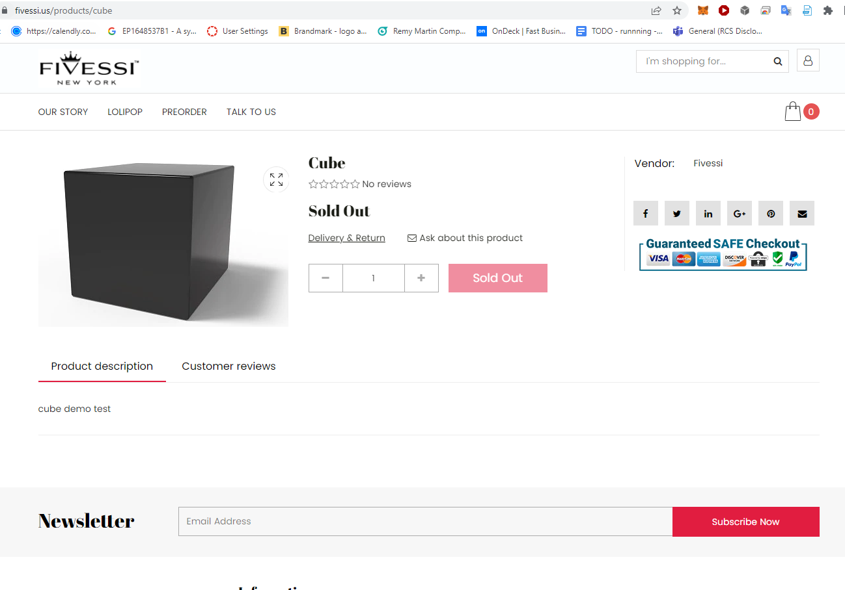
Customer buys NFT on Merchant website

Slide 3
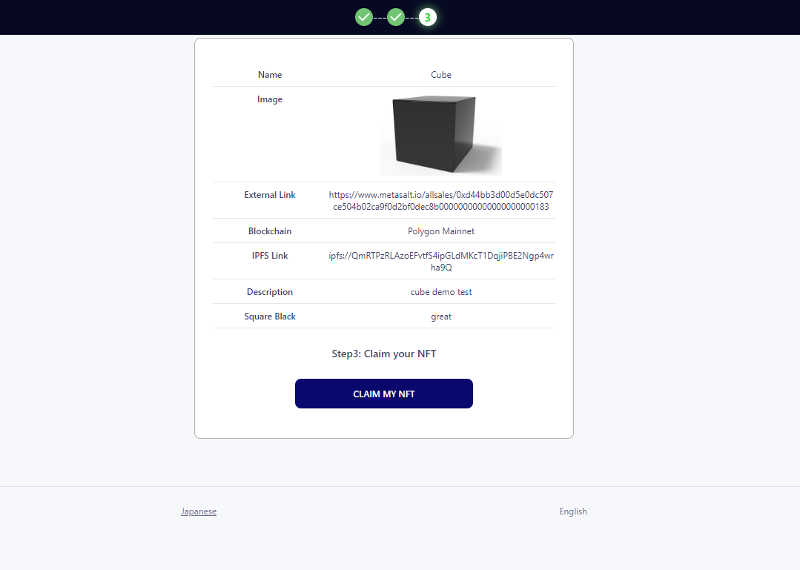
Customer receive email with Claim Mint page

Slide 4
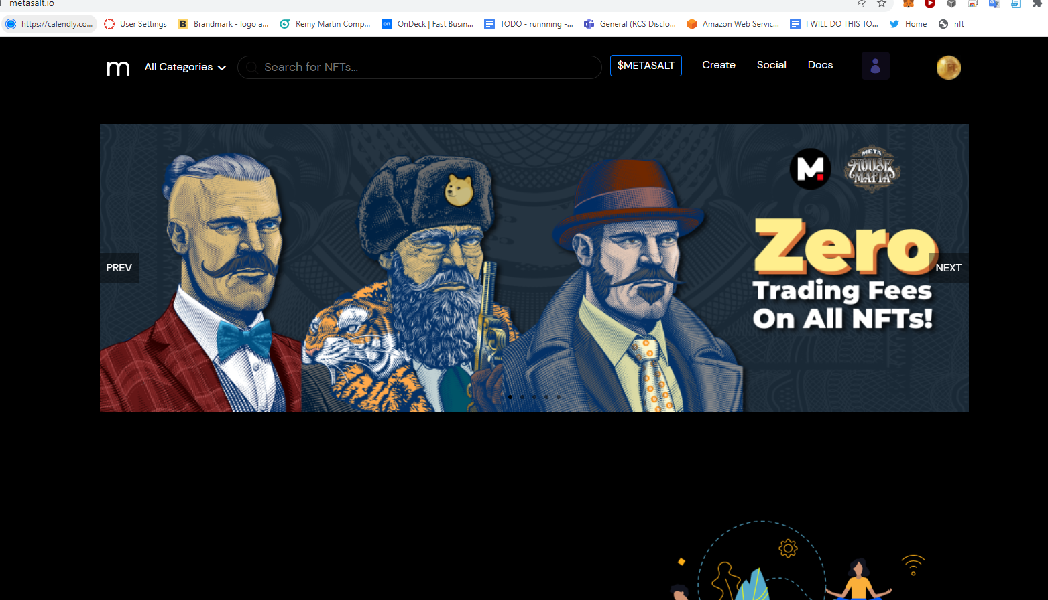
Customer signs up using Magic Link onto Metasalt.io

Slide 5
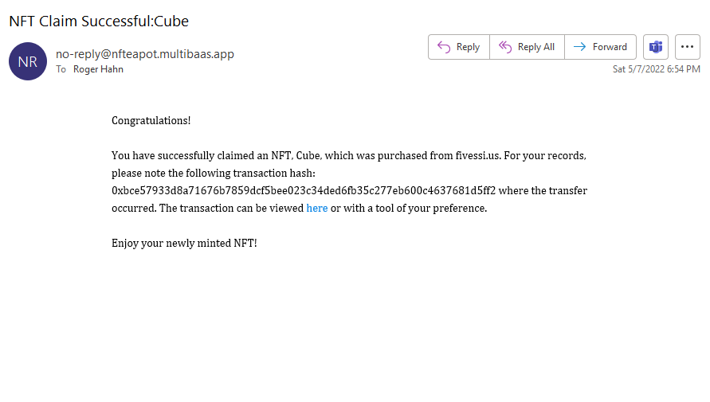
Customer receive confirmation email token minted

Slide 6
NFT ticketing Options on Merchant’s collection and Brand page
Online
Meeting
Zoom
Go-to-Meeting
Content on 3rd party
youtube
Website
Gucci
Shopify
Groups
Slack
Discord
In-Person
Eventbrite/Meetup
Club/Party
DAO

Slide 7
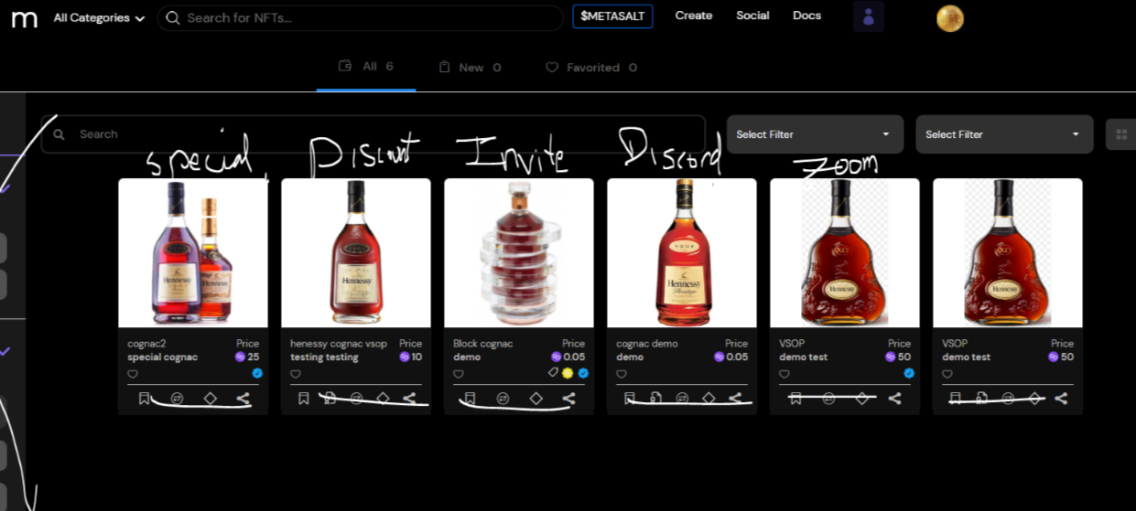
TOKEN-GATED CARDS

Slide 8
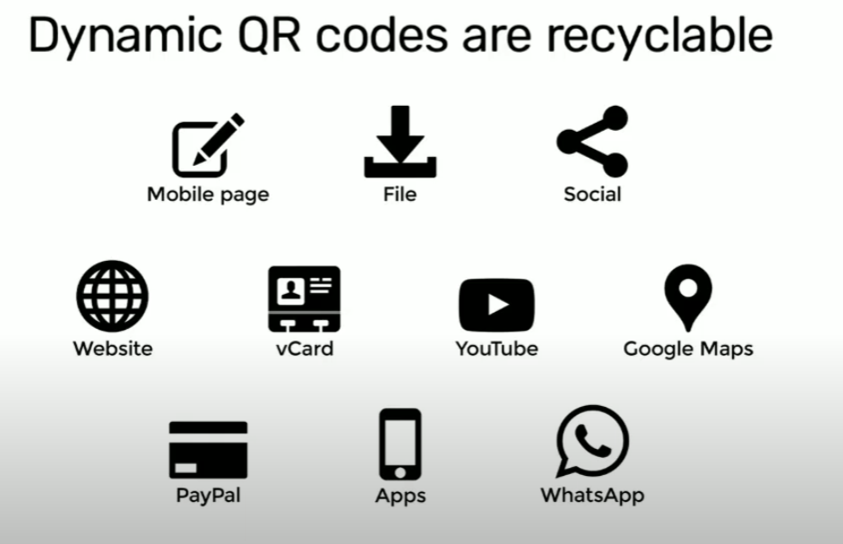
Collection has token-gated cards

